Slide 1
The role of VEGFA in disease progression of myelodysplastic syndrome
Shin Seung-Hwan, M.D., Ph.D.

Slide 2
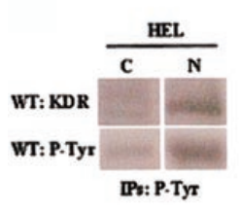
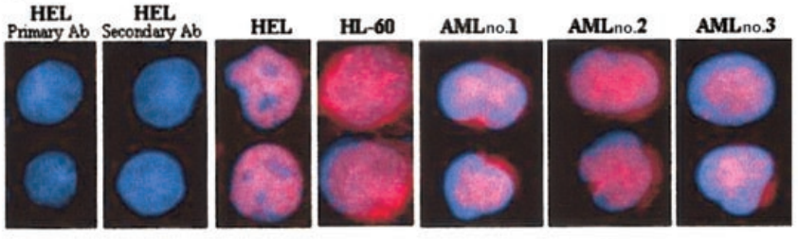
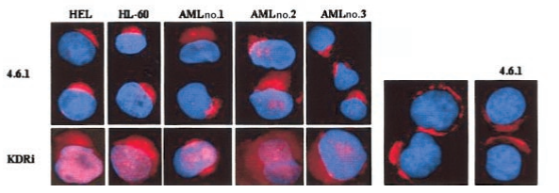
BACKGROUND
Internal and external autocrine VEGF/VEGFR2 loops
Phosphorylated VEGFR2 in the nuclear protein fractions of untreated cells, suggesting the autocrine loop might result in VEGR2 activation
Blood. 2004 May 15;103(10):3883-9.

Slide 3
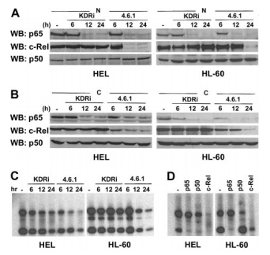
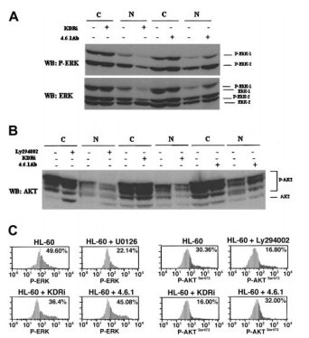
BACKGROUND
Internal and external autocrine VEGF/VEGFR2 loops
Anti-VEGF Ab. blocks NF-κB
VEGFR2-specific intracellular inhibitor (4.6.1) blocks MAP3 and PI3K pathway
Blood. 2004 May 15;103(10):3883-9.

Slide 4
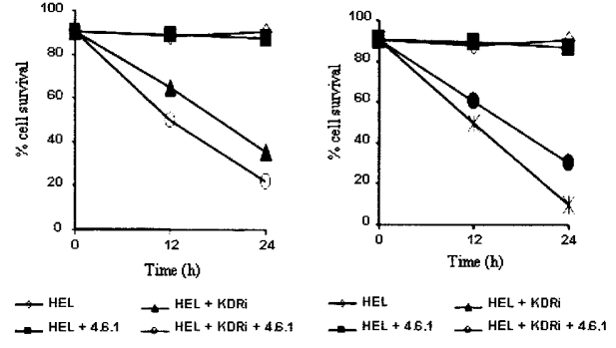
BACKGROUND
Internal and external autocrine VEGF/VEGFR2 loops
Anti-VEGF Ab. – a little effect on cell survival
VEGFR2-specific intracellular inhibitor – induced leukemia apoptosis
Anti-VEGF Ab. + VEGFR2-specific intracellular inhibitor – reduce cell survival to larger extent than either agent alone
Blood. 2004 May 15;103(10):3883-9.

Slide 5
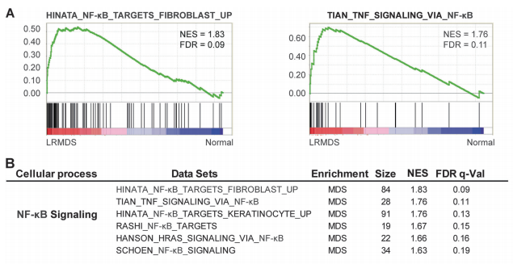
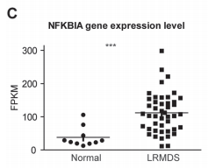
BACKGROUND
Activation of NF-κB driven inflammatory programs in mesenchymal elements attenuates hematopoiesis in lower-risk MDS
Gene set enrichment assay (GSEA) – a remarkable abundance of signatures related to the activation of the nuclear factor-kappa B (NF-κB) family of transcription factors
Leukemia. 2019 Feb;33(2):536-541.

Slide 6
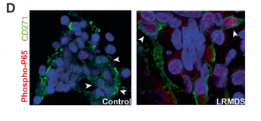
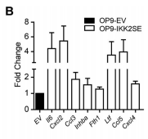
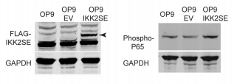
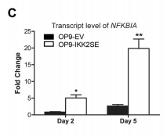
BACKGROUND
Activation of NF-κB driven inflammatory programs in mesenchymal elements attenuates hematopoiesis in lower-risk MDS
Increased phosphorylation of p65 in intramedullary located CD271+ mesenchymal cells
OP9 cells (like CD271+ cells) – support the expansion of human HSPCs
IKK2SE – a constitutively active form of IKK2 (a upstream regulator of NF-kB)
Transfection by lenti-virus
Leukemia. 2019 Feb;33(2):536-541.

Slide 7
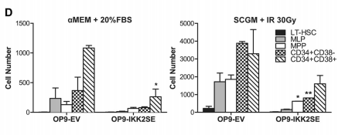
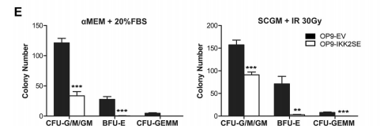
BACKGROUND
Activation of NF-κB driven inflammatory programs in mesenchymal elements attenuates hematopoiesis in lower-risk MDS
Leukemia. 2019 Feb;33(2):536-541.

Slide 8
The role of VEGFA in disease progression of myelodysplastic syndrome (MDS)
Sample selection (VEGF_{high}/VEGF_{low})
VEGF_{high}
BM blast_{high} – UPN 3 (18%, 13.60), UPN 77 (13%, 17.39), UPN 79 (15%, 27.86), UPN 112 (30%, 23.08), UPN 124 (77%, 23.24)
BM blast_{low} – UPN 32 (1%, 23.59), UPN 60 (9%, 21.41), UPN 75 (0%, 16.74), UPN 78 (7%, 39.53), UPN 80 (4%, 26.72)
VEGF_{low}
BM blast_{low} – UPN 14 (1%, 2.01), UPN 35 (0%, 1.790), UPN 38 (6%, 4.94), UPN 54 (2%, 1.08), UPN 57 (7%, 4.84)
BM blast_{high} – UPN 15 (14%, 5.33), UPN 28 (10%, 10.06), UPN 30 (9%, 3.97), UPN 50 (10%, 10.37), UPN 81 (18%, 11.79)

Slide 9
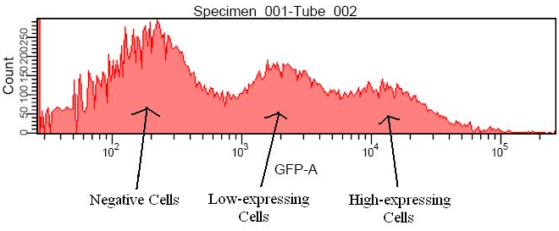
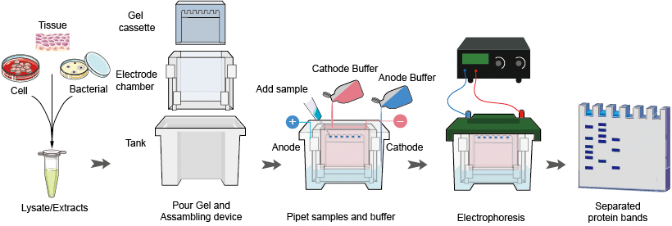
The role of VEGFA in disease progression of myelodysplastic syndrome (MDS)
Q1 – Is protein expression of VEGFA increased in MSC cells or culture media?
Method
Flow cytometry
Western blot
Cell
Cell

Slide 10
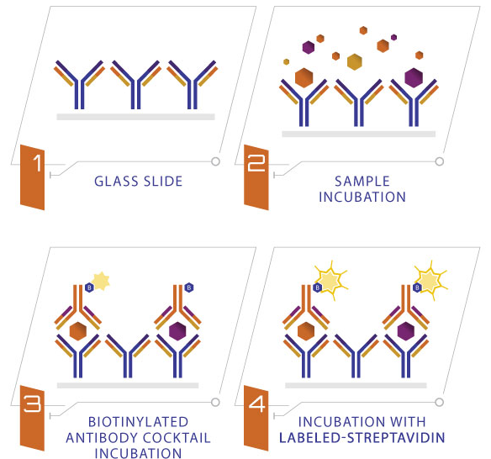
The role of VEGFA in disease progression of myelodysplastic syndrome (MDS)
Q1 – Is protein expression of VEGFA increased in MSC culture media?
Method
ELISA
Culture media

Slide 11
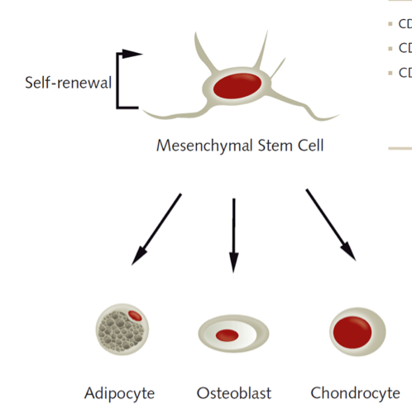
The role of VEGFA in disease progression of myelodysplastic syndrome (MDS)
Q2 – Dose VEGFA change MSC characters?
Method
VEGF_{high} culture media + MSC
VEGF_{low} culture media + MSC
Characterization
Cell proliferation
Stemness
Differentiation

Slide 12
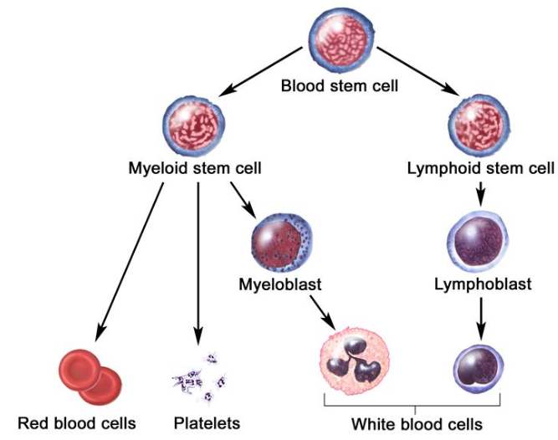
The role of VEGFA in disease progression of myelodysplastic syndrome (MDS)
Q3 – Dose VEGFA change HSC/LSC characters?
Method
VEGF_{high} culture media + HSC/LSC
VEGF_{low} culture media + HSC/LSC
Characterization
Cell proliferation
Stemness
Differentiation

